Slide 1
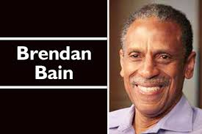
E-newsletter : July –September 2017
www.jchs.org.jm jchsadvocate@gmail.com
Tel: (876) 779-6219
Education. Advocacy. Ministry.
Highlights
Judgement in Professor Bain v UWI case
UN 1st LGBT Czar resigns
Concerns about National ID & Registration Bill
New feature: What Christians needs to know about Islam
What’s been happening: Jamaica
Court hands down judgement in Bain v UWI case
The long awaited decision of the Jamaican Full Court in the case of Professor Brendan Bain v The University of the West Indies (UWI) was delivered on Monday July 31, 2017.
Professor Bain had sued the UWI for
wrongful dismissal from his post as Director
of the Regional Coordinating Unit of the
Caribbean HIV/Training Network (CHART).
CHART trains healthcare personnel working with HIV/AIDS clients, and was overseen by the University of the West Indies (UWI).
The lead organisation was the Caribbean Vulnerable Communities Coalition (CVC) headed by Dr Carolyn Gomes.
These groups and UWI clamed that Professor Bain’s participation as an expert witness in the Belize ‘buggery law’ constitutional case caused them, the alleged primary beneficiaries of the CHART programme, to lose confidence in him following his participation in a HIV/AIDS court case in Belize.
In his expert testimony to the Belize case, Professor Bain had provided factual evidence about the risk of HIV/AIDS among men who commit buggery with men.
Professor Bain sued the UWI claiming
the UWI breached s.13 (3) (b) and (c) of the
Charter of Rights (freedom of thought and expression)
and caused defamation to his reputation. He also sought
recovery of outstanding monies owed to him by the UWI.
The case was heard before a three member panel of judges: the Hon. Mr Justice Lennox Campbell, the Hon. Ms Paulette Williams and the Honourable Mr Justice Frank Williams in January 2015. In their judgment, the judges stated that it was factually accepted by both parties that Professor Bain is a well- respected and seasoned professional with a distinguished career in academia and medicine, a pioneer in clinical infectious disease practice in Caribbean and a leading medical authority on HIV epidemic in Caribbean[para.8 of the judgment]
Although the UWI had claimed that Professor Bain’s testimony to the Belize case led to loss of confidence of a ‘significant sector of the community that CHART was intended to reach’, the Court did not find any ‘evidence of anything happening in the CHART programme that would have led to the conclusion that Prof Bain’s leadership was being called into question.’ [para.107]
Justice Paulette Williams stated that ‘it could not be denied that the root cause of the termination of the claimant’s contract was the testimony he had given and the “firestorm’ that followed due to the insistence by the CVC that the claimant be removed from his leadership position.’ [para.112]
The Court therefore ruled that UWI’s dismissal of Prof Bain was ‘violation of [his] right to freely express himself, in the manner he did when giving the report he called upon by a court of law to give. [para.134] The dismissal was not demonstrably justified in a free and democratic society [para.159].
Justice Frank Williams found that UWI’s action of saying that it respected freedom of expression but also firing someone for exercising that freedom, appeared ‘somewhat hypocritical or conflicted’. The UWI must be seen as ‘saying in effect- you can express yourself freely or as you want so long as you say what we ( or others in the mainstream) want you to say. Or put another way, you are free to express yourself as you see fit, but if you say anything that does not accord with our policy or affects our finances, then you have to go’ [para.333]. He also commented that Prof Bain expert testimony to the Belize case was a ‘balanced, fair and impartial report’ [para.329]
On May 19, 2014, Professor Bain was fired from his post by the Vice Chancellor of the UWI, Professor E. Nigel Harris on the demand of 33 purported Caribbean LGBT activist groups. Some of these groups were subsequently reported to be ghost organisations.

Slide 2
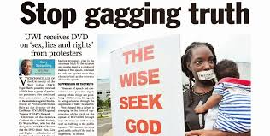
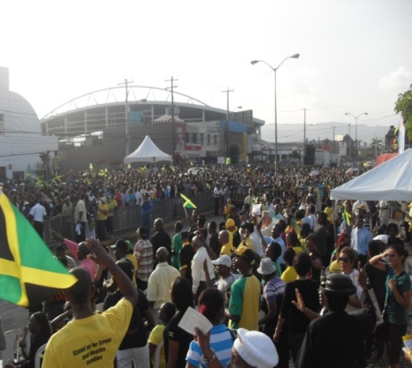
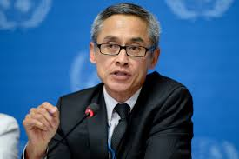
Newsletter: Sept 2017
The Court did not agree however, that his reputation was defamed as a result of the UWI action. The Court nevertheless ruled that Professor Bain was due payment in lieu of notice as the contractually required 3 months notice of termination was not adhered to.
Professor Bain’s dismissal had sparked outrage which was expressed in newspapers across the Caribbean, airwaves, online (an international petition garnered over 2000 signatures) and a 6 week-long silent protest outside the main gates of the UWI, Mona campus in Kingston. This protest was said to be longest running public protest in Jamaica's recent history.
RED FLAG: National ID & Registration Bill
The National Identification and Registration Bill seeks to establish an all encompassing identification system. It contains several troubling elements. For example, the system will be mandatory for all Jamaicans from age 6, with a fine of $100,000 for failure to enroll; citizens will not be permitted to access certain “goods or services provided by a public body” without the ID; your finger prints, and possibly retina scan, vein pattern of the hand, foot print, toe print, palm prints and blood type are invasive demands and beyond the norm. Other issues that arise include possible breaches of constitutional rights, protection against security leaks, misuse of data and judicial remedies in case of identity theft.
An August 2017 ruling by the Indian Supreme Court that privacy is a fundamental right challenges the validity of a similarly designed ID system in India. Among other issues, citizens without an ID were denied access to free midday meals at schools and subsidies for rice and other staples. https://www.theguardian.com/world/2017/aug/24/indian-court-rules-privacy-a-fundamental-right-in-battle-over-national-id-cards
The Jamaican bill was passed by the lower House and is now to be debated by the Senate. We invite you to review the Bill and send your concerns to the Office of the Prime Minister and Parliament before this invasive bill becomes law .
A copy of the draft law is available here: www.japarliament.gov.jm/attachments/article/339/The%20National%20Identification%20and%20Registration%20Act,%202017--.pdf
Protestors wore black, carried placards and placed tape over their mouths inscribed with the words ‘Freedom of Speech’. All this to indicate the symbolical death of freedom of speech in the very place where expression of independent thought ought to have been freely encouraged. Protest were also held in Jamaica’s second capital city Montego Bay, and in Belize City, Belize.
The protests culminated in a mass public rally in Half Way Tree square on Sunday June 29, 2014 organised by Jamaica CAUSE (Churches Action Uniting Society for Emancipation).
UWI protests, 2014
Jamaica Cause Rally 2014
What’s been happening: United Nations
UN LGBT Czar resigns after 1 year in post
Jamaican docu-film on human trafficking
Christian youth organisation the Love March Movement (LMM) has written and produced a 30 minute docu-film entitled ‘Traffick Blocking’ to aid in educating the public on the harsh realities of human trafficking and how they can best prevent themselves from becoming victims of the trade.
Read more: http://www.jamaicaobserver.com/entertainment/traffick-blocking-aims-to-enlighten_111892?profile=1116
Copies of the DVD are to be made available to schools, churches, youth clubs and other community associations. Your partnership in getting the word out would be appreciated. For more information, please contact: younglivesmatter876@gmail.com.
In our March 2017 newsletter we reported that on December 19, 2016, United Nations Member states in New York, USA, voted on the post of an Independent Expert on protection against violence and discrimination based on sexual orientation and gender identity. 84 countries voted for the post, 77 against and 18 abstained. The Expert who was appointed, Mr Vitit Muntarbhorn (picture below) from Thailand, is a prominent ‘gay’ rights activist who was given a broad mandate to push across the world, the acceptance of deviant sexual behaviours, as normal.
The film was premiered at the Palace Cineplex, Sovereign Centre in Liguanea on Saturday, September 23, 2017.
However, one year on, Mr Mountarbhorn has resigned from the post effective 31 October 2017. He cited illness, hospitalisation, and illness of a family member. The post remains open however and the UN is expected to take a decision on a possible replacement in December 2017.
See more: https://www.usnews.com/news/world/articles/2017-09-22/first-un-expert-on-gender-identity-resigns

Slide 3
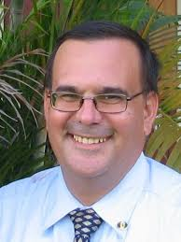
Newsletter : Sept 2017
What’s been happening: UK
In our June 2017 newsletter, we reported on Charlie Gard (picture below), the eleven-month old baby with a form of mitochondrial disease, a condition that causes progressive muscle weakness and brain damage. His parents, Connie and Chris (at right), independently raised over £2 million to take him to the United States for experimental but potentially promising treatment.
When one thinks of the history of the Middle East
perhaps, the exotic ‘Arabian Nights’ bedtime stories
come to mind. However, the Islam that is the subject
of lovely and happy fables is far from the truth.
All Christians should have an objective understanding of Islam.
Did you know that the word Islam is derived from the Arabic root “Salema” meaning peace, purity, submission and obedience”? In the religious sense, Islam means submission to the will of God and obedience to His law. (www.barghouti.com 2017).
According to the United Nations (UN), there are 50 nations out of 195 that are Muslim nations (2010) and between 1.6 billion to 1.8 billion Muslims on the Earth. At the same time, Christianity remains stagnant at 1.2 billion and we must thank God for our zealous brothers and sisters from Africa and Latin America who continue to spread and practice the Word of God.
Here in Jamaica we have 2 communities of Muslims, one more orthodox than the other. One of them is the denomination Sunni which emphasizes God’s power in the material world, including the public and political realm. The other denomination is the Shiites and they value martyrdom and sacrifice. (The New York Times, 2016). They are across the country living in closed communities, are always ready to debate with anyone and are proselytising persons. You must know that a good Muslim memorizes his Koran (The Word) and studies his Hadiths (tradition) seriously.
The young Muslim goes to the Koran school to perfect his knowledge of the word and tradition and to be ready if he is willing to be an Iman. The Iman is the leader of the congregation and has the responsibility of the souls of his people and it is why he teaches a lot, explains and debates the Koran. One of his principal activities is a long predication where he teaches and exhorts to all Muslims to follow strictly the word of Allah.
According to the Islamic faith, Mohammed is the prophet who received the word from God. In 622 A.D. an important event known as the Hegira or Hijrath is the migration or journey of the Islamic prophet Muhammad and his followers from Mecca to Yathrib, later renamed by him to Medina, in the year 622. In June 622, after being warned of a plot to assassinate him, Muhammad secretly left his home in Mecca to emigrate to Yathrib, 320 km (200 miles) north of Mecca, along with his companion Abu Bakr. Yathrib was soon renamed Madīnat an-Nabī (literally "City of the Prophet"), but an-Nabī was soon dropped, so its name is "Medina", meaning "the city". The Hijrah is also often identified with the start of the Islamic calendar, which was set to Julian 16 July 622. (Wikipedia, 2017)
In the next installment, I will share with you the 5 pillars of the Muslim faith and their potential implications in our daily lives. YB
However, the admitting hospital blocked
his transfer. His parents undertook an
intensive legal challenge against the
hospital which garnered significant
international attention. Charlie’s condition
eventually deteriorated and his parents
ended the legal battle. Charlie was transferred to a hospice for his final hours. He died on Friday July 28, 2017.
*******
ABOUT US: The JCHS is a family advocacy NGO promoting Judeo-Christian principles as the most coherent framework for defining family, ordering society and promoting human flourishing.
WHAT WE DO: ●Public education ●Public rallies ● Media intervention ●Lobbying Government and civil society stakeholders ●Legal and policy papers.
Like us on Facebook. Follow us on Twitter and Subscribe to our YouTube channel!
Please watch the JCHS documentary:
Sex Lies & Rights: a seduction of law, medicine and politics. www.youtube/jchsadvocate
See previous JCHS newsletters: www.jchs.org.jm/newsletters.html
PRAYER POINTS:
Wisdom and humility for national leaders
Establishment of Joint Select Committee to review National ID Bill
Stable family life so that all Jamaica’s parents will raise their children well.
With Thanks !
Your Financial support
Scotiabank, 82-84 Half Way Tree Road, Kingston 10
Savings Account # 936 361 Transit # 60145
Swift Code NOSCJMKN
“For the weapons of our warfare are not carnal,
but mighty through God
to the pulling down of strong holds;
Casting down imaginations, and every high thing that exalteth itself against the knowledge of God,
and bringing into captivity every thought to
the obedience of Christ.”
2 Cor. 10:4-5 KJV

